Slide 1


Microprocessor Architecture and Internet of Things (MAIOT)
Course Code: CET3014B Credits: 3 TH+2 Lab=5

Slide 2

Course Structure - SY

Slide 3

CCA LCA

Slide 4
Unit wise distribution of CCA-70 Marks
LCA-30 Marks

Slide 5
Syllabus
Module I: Overview of Embedded System and IoT
Module II:Pentium Architecture:
Embedded Systems: Architecture & Characteristics of ES, Types of Embedded systems, Examples of Embedded Systems. Introduction of IoT: Definition and characteristics of IoT, Technical Building blocks of IoT, Device, Communication Technologies, Data, Physical design of IoT, IoT enabling technologies, IoT Issues and Challenges- Planning, Costs and Quality, Security and Privacy, Risks. Example: Smart Home /Smart Agricultural.
Pentium features, Pentium superscalar architecture - Pipelining, Branch prediction, and Instruction and Data caches. The Floating-Point Unit: features, pipeline stages & data types. Pentium programmer's model, register set, System registers, addressing modes and Instruction set.

Slide 6
Syllabus
Module III:Pentium Operating Modes:
Pentium Modes of Operation, Pentium Real address mode: Memory organization, Memory segments, segment registers, logical to physical address generation
Protected mode: Segmentation unit support registers, related instructions, segment Memory descriptors, logical to linear address translations.
Module IV:Paging and Protection:
Paging Unit: support registers, related data structures, linear to physical address translation, TLB Protection by segmentation, privilege-levels, rules of inter-privilege level transfer for data and code segments, page level protection.

Slide 7
Syllabus
Unit 5: Pentium Task Management and Interrupt Handling:
Task Management, support registers, related data structures, Task switching.
Interrupt and Exception Overview, Sources of Interrupts & exceptions, Exception and Interrupt Vectors,
Interrupt Descriptor Table (IDT), IDT Descriptors,
Exception- or Interrupt-Handler Procedures

Slide 8
Learning Resources:
Text Books:
1. The Internet of Things by Hakima Chaouchi Publishers: ISTE and Willey
2. James Antonakos, “The Pentium Microprocessor”, 2004, Pearson Education ISBN – 81-7808-545-3.
Reference Books:
1. Beginning Arduino by Micheal McRoberts Publishers: Technology in Action
2. IoT Fundamental by Devid Hanes Publishers: CISCO
3. Raspberry Pi Cookbook for Python Programmers by Tim Cox Publishers: PACKT
4. The Official Raspberry Pi Project Book
5. Beginning Sensor Networks with Arduino and Raspberry Pi by Charles Bell Publishers: Technology in Action
6. Intel architecture software developer's manual volume 3.
7. Intel architecture software developer's manual volume 1.
8. Intel 64 and IA-32 Architecture’s software developer's manual

Slide 9
Course Objectives:
By participating in and understanding all facets of this Course a student will be able:
1. Knowledge:
i. To understand the components and techniques used in IoT development environment
ii. To apply the knowledge of fundamentals in IoT for various applications.
iii. To acquire the knowledge of the Pentium processor architectural features, programmer’s model, system registers.
2. Skill:
i. To learn Pentium addressing modes and instruction set for the development of x86/64-bit assembly language programs.
3. Attitude:
i. To describe the role of Memory Management Unit and Privilege levels in protected mode of Pentium processor.
ii. To learn the role of CPU in handling multitasking and processing of interrupts and exceptions in Pentium environment.

Slide 10
Course Outcome:
By the end of the course, students will be able to
1. Describe the details of IoT based systems.
2. Demonstrate the use of common IoT platforms and installations.
3. Discuss Pentium Architecture and Programmer’s Model.
4. Apply the Assembly Language Programming skills of Pentium processor.
5. Interpret the demand Paging and Protection Mechanism supported in Pentium Architecture.
6. Demonstrate the concept of Task Management and Interrupt Handling within the Pentium processor.

Slide 11
Unit 2: Pentium Architecture
Pentium features, Pentium superscalar architecture - Pipelining, Branch prediction, and Instruction and Data caches.
The Floating-Point Unit: features, pipeline stages & data types.
Pentium programmer's model, register set, System registers.
Addressing modes and Instruction set.

Slide 12
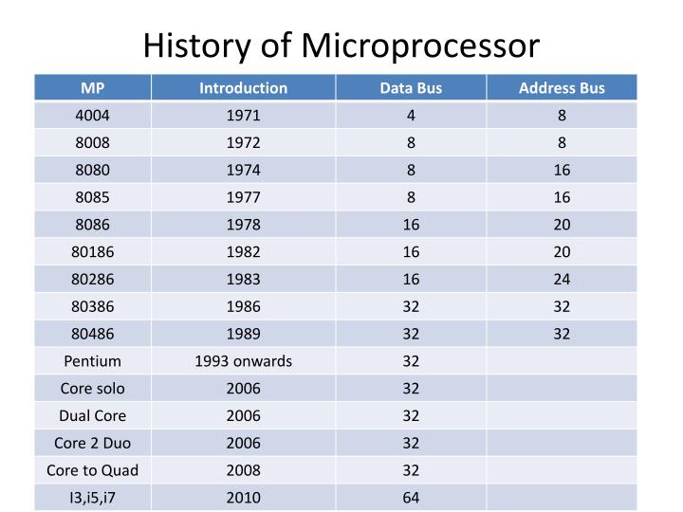


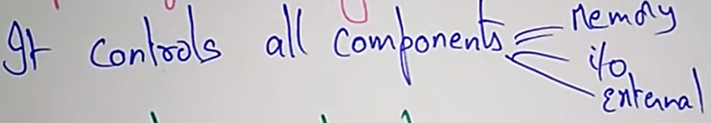






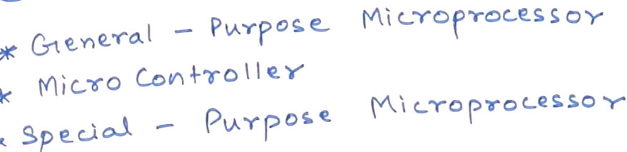
Extra Information
https://www.youtube.com/watch?v=xrUvFJWlYCY

Slide 13
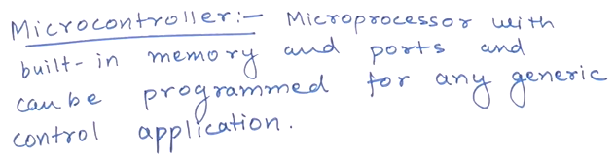
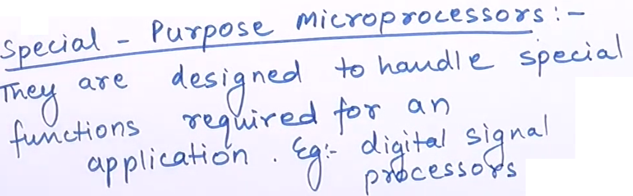
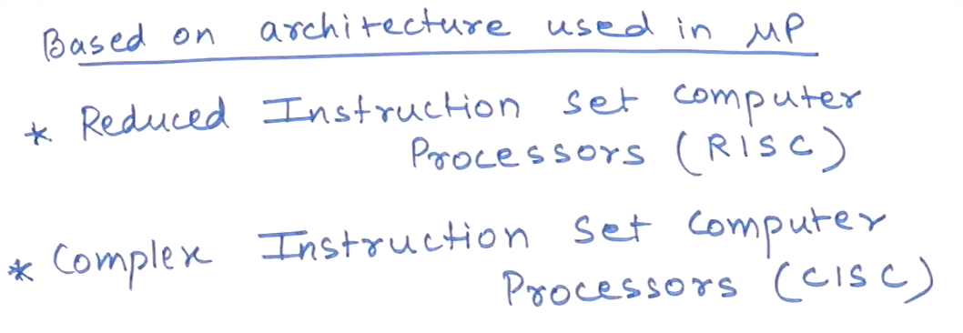
Extra Information

Slide 14




Slide 15
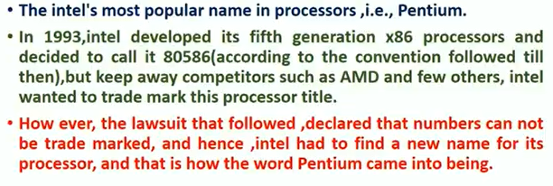


Slide 16
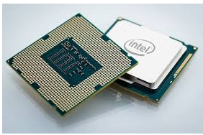

Pentium Processor

Slide 17
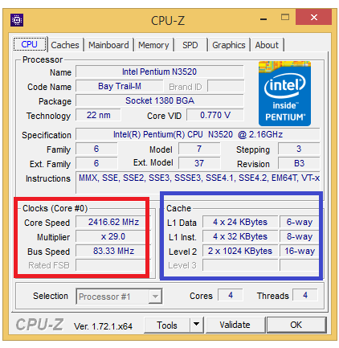
Typical specifications – Only for information
https://cpu-z.en.uptodown.com/windows/download
https://www.youtube.com/watch?v=W9Pq32f2rsQ

Slide 18
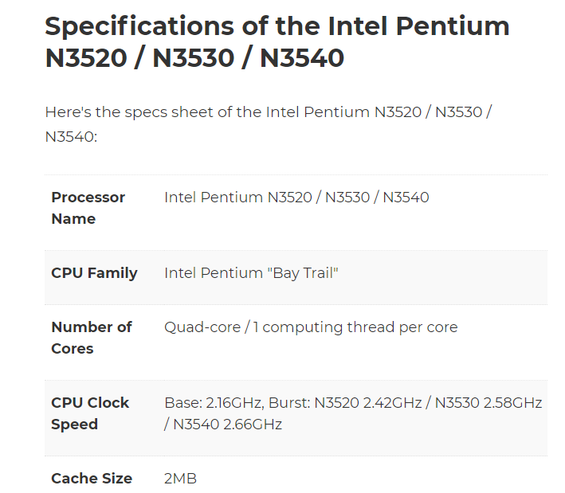
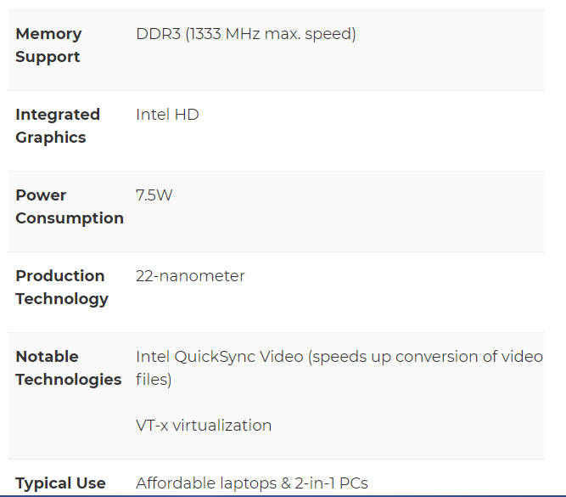
Typical specifications – Only for information
Double Data Rate (DDR)

Slide 19
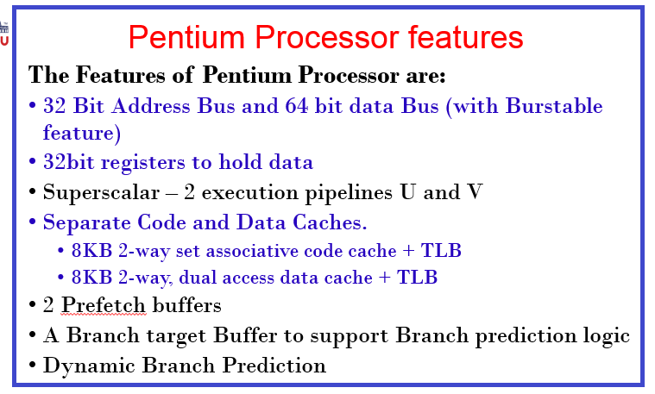
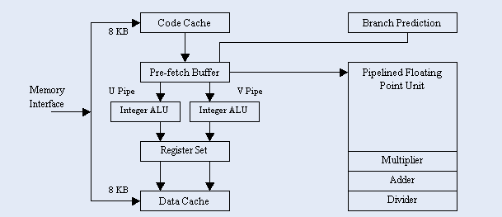
Pentium Architecture
Components of Pentium Architecture

Slide 20
Pentium Processor Features
The Features of Pentium Processor are:
32bit registers to hold data.
32 Bit Address Bus and 64 bit data Bus (with Burstable feature)
Able to be burst. Having the ability to exceed the normal maximum bandwidth for short periods
Address bus decides the memory addressing capacity of processor
Address lines are 32 so memory can be addressed = 2^32 = 4GB
Data bus governs the data handling/processing capacity i.e. maximum size of data can be operated on.
Size of data and address bus should be as large as possible to improve system performance
Use/role of the above Feature in Pentium Performance

Slide 21
Pentium Processor Features
The Features of Pentium Processor are:
Superscalar – 2 execution pipelines U and V
Any architecture which supports parallel computing through massive pipelining is called as superscalar architecture.
Pipeline implements parallel/overlapped operations in the system and uses all the resources (Buses, ALU, Decoding unit etc.) to the optimum level.
System throughput is improved. Throughput is proportional to frequency in ideal case.(How much data can be transferred from one location to another in a given amount of time. )
Ex. Pipelined Vs Non pipelined operation
https://www.youtube.com/watch?v=AsthZgIS2Lw&list=PLm_MSClsnwm8Dw5nmh8A5E7gO06j1TeIa
Use/role of the above Feature in Pentium Performance

Slide 22
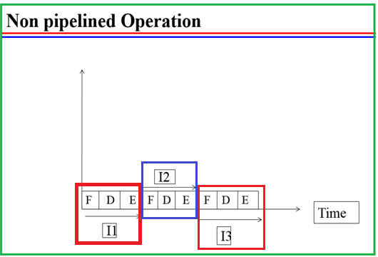
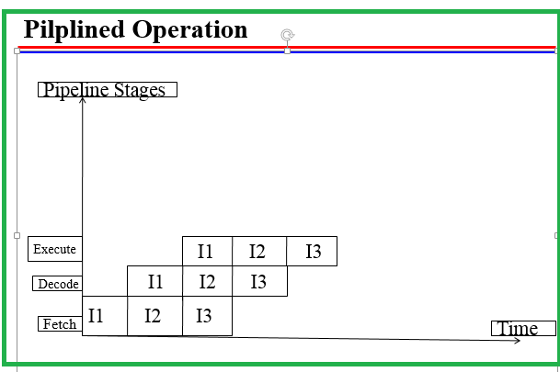
Speed up = [nkt] / [kt+ (n-1)t] = nk / [k + n-1] = k / [ 1 + (k-1)/n ]
Speed up ~ k (approx.) as n >> k
n = No. of Operations
K = No. of Pipeline stages
t = Time required at each pipeline stage

Slide 23
Pentium Processor features
The Features of Pentium Processor are:
Separate Code and Data Caches.
8KB 2-way set associative code cache + TLB (Translation Lookaside buffer)
8KB 2-way, dual access data cache + TLB
Separate code and data cache balances load on buses so operations are faster.
Memory Management is improved by insertion of TLB – Translation Lookaside buffer between processor and cache.
Cache organizing Techniques:
(i): Direct Mapping (ii) Fully Associative (iii) Set Associative
Use/role of the above Feature in Pentium Performance

Slide 24
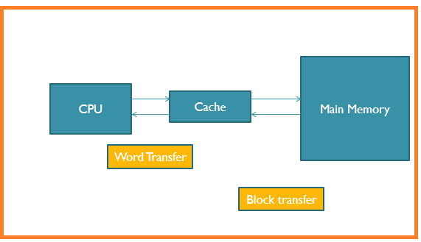
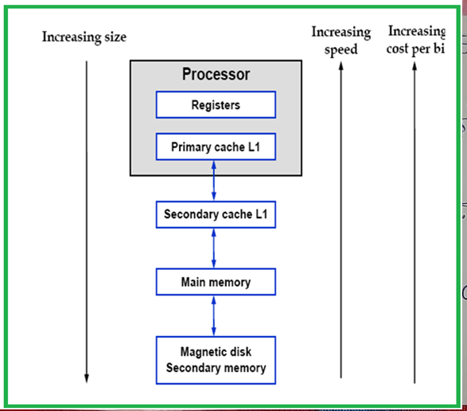
Only for Understanding

Slide 25
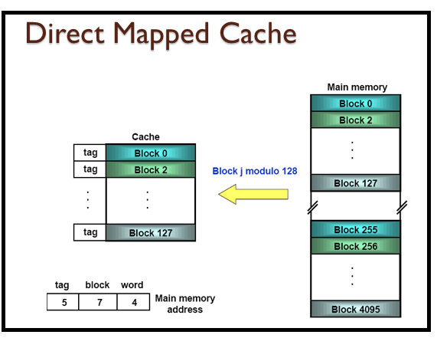
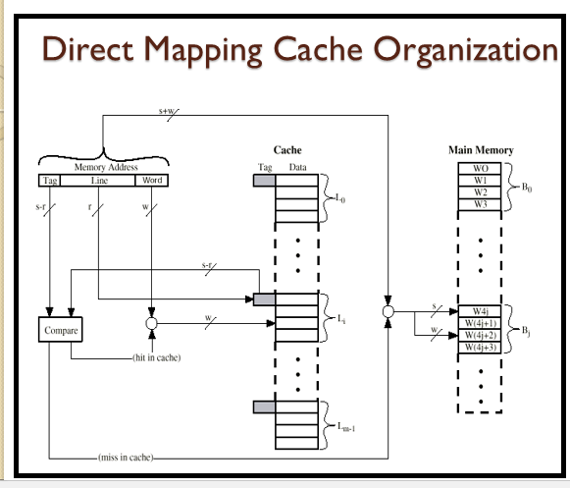
Only for understanding

Slide 26
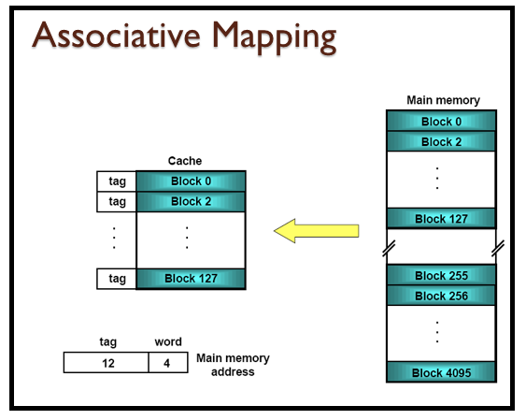
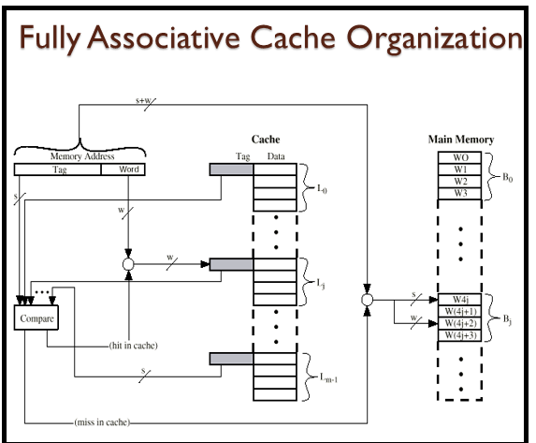
Only for understanding

Slide 27
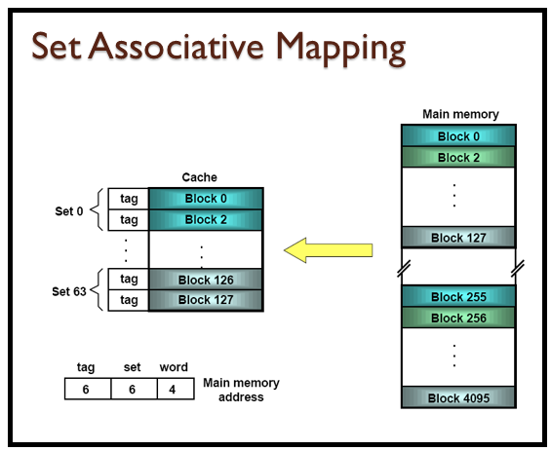
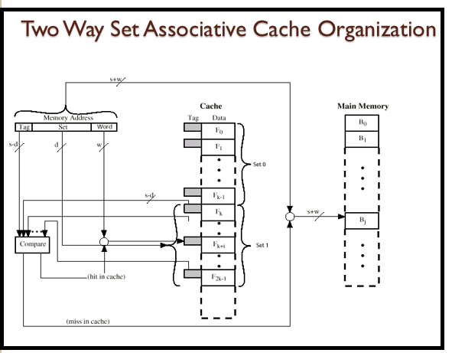
Only for understanding

Slide 28
Pentium Processor features
The Features of Pentium Processor are:
2 Prefetch buffers
A Branch Target Buffer to support Branch prediction logic
Dynamic Branch Prediction
Branch prediction logic is implemented using Prefetch Buffer and Branch Target Buffer (BTB).
Branch prediction logic reduces branch penalty (in no. of cycles required to flush the pipeline and reload the pipeline with target instructions)
Branch prediction can be Static or Dynamic in nature.
Detailed explanation in later subsection of the unit.
Use/role of the above Feature in Pentium Performance

Slide 29
Pentium features
Pipelined Floating-Point Unit (FPU)
Improved Instruction Execution Time
Separate pipeline to process floating point numbers.
Availability of U and V pipes improves system performance by reducing instruction execution time.
Use/role of the above Feature in Pentium Performance

Slide 30
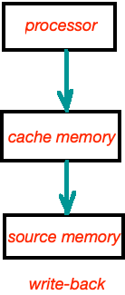
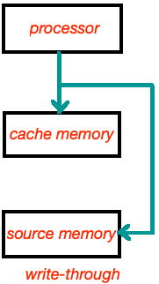
Pentium features
Write back MESI Data Cache 4=2=00,01,10,11
(Modified/Exclusive/Shared/Invalid) Protocol in the
Cache Updation Policies------
Write Back:Writing is done only to the cache.
Write Through: Write is done synchronously
both to the cache and to the backing store.
Use/role of the above Feature in Pentium Performance

Slide 31
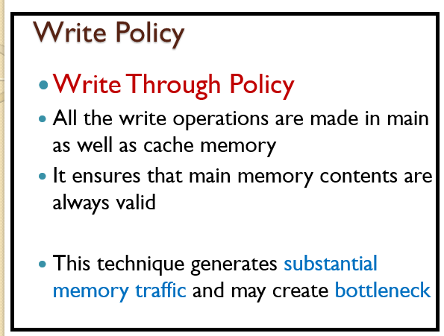
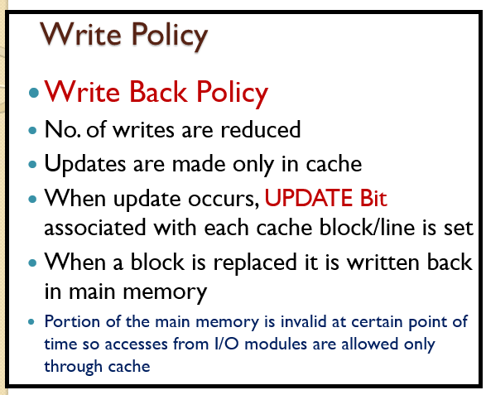
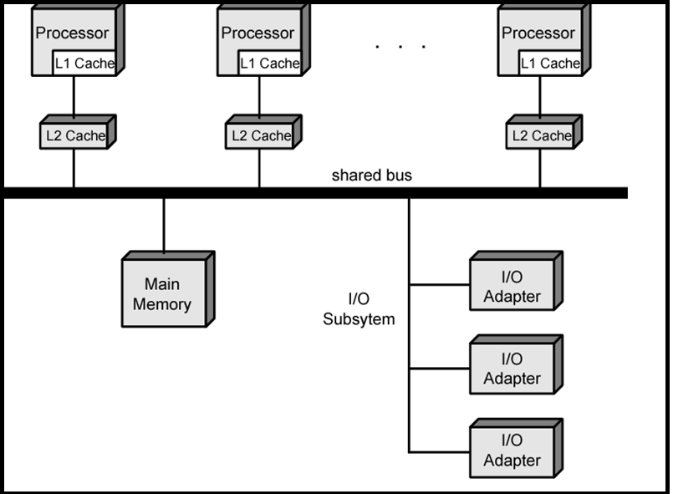
Only for understanding

Slide 32
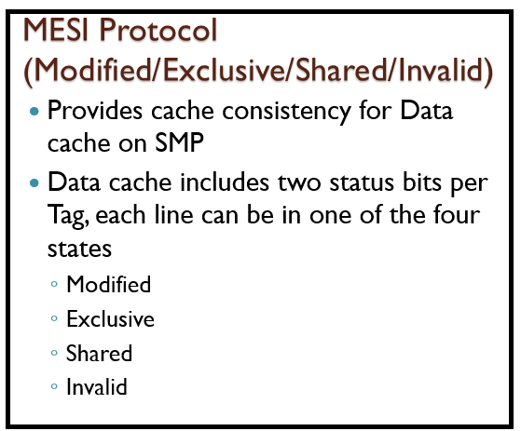
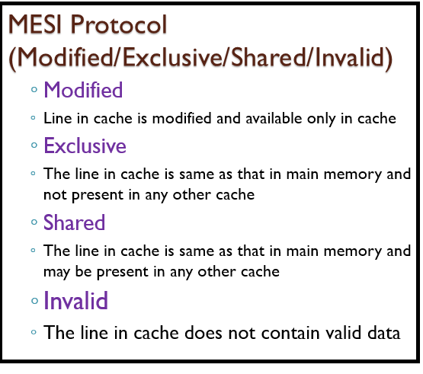
Only for understanding

Slide 33
Only for understanding

Slide 34
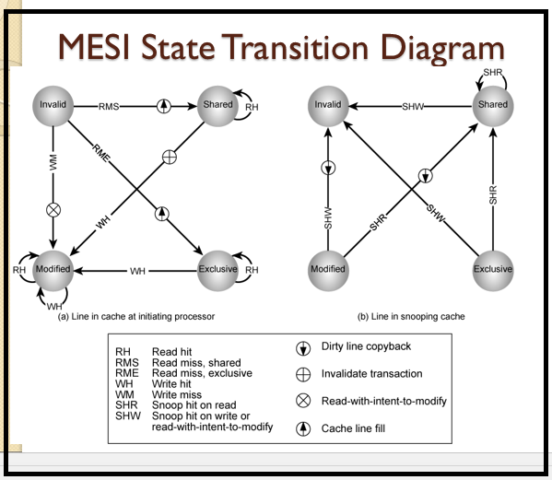
Only for understanding

Slide 35
Pentium features
System Management Mode
Provides Power Management mechanisms
Execution Tracing
The Pentium 4's execution trace cache stores micro-operations (Execution of an instruction (the instruction cycle) has a number of smaller units —Fetch, indirect, execute, interrupt, etc • Each part of the cycle has a number of smaller steps called micro-operations) resulting from decoding x86 instructions, providing also the functionality of a micro-operation cache.
Having this, the next time an instruction is needed, it does not have to be decoded into micro-ops again.

Slide 36
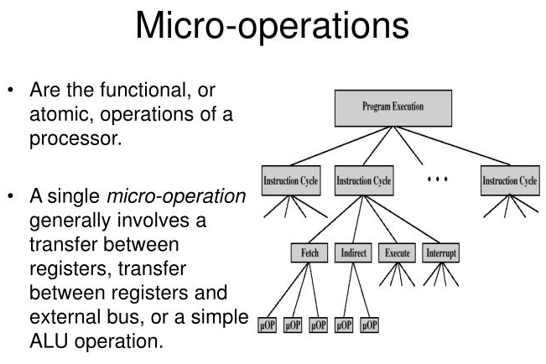
Only for understanding

Slide 37
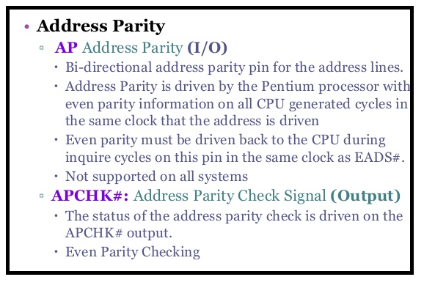
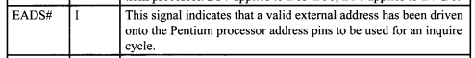
Pentium features
Address parity (from the Latin parity, meaning equal or equivalent)
AP:This signal can also be used along with APCHK# and EADS# for snooping cycles.
APCHK#(Output): When the Pentium processor has detected address parity errors on an inquire or snooping cycle, the Address Parity Check (APCHK#) status signal is asserted 2 clock cycles after EADS#.

Slide 38
Pentium features
Virtual Mode Extension-----
The virtual mode extensions are very useful to memory managers and multitasking operating systems.
Memory managers can primarily benefit by the use of the interrupt redirection bit map to reduce the number of switches to and from protected mode.
https://www.youtube.com/watch?v=o2_iCzS9-ZQ

Slide 39
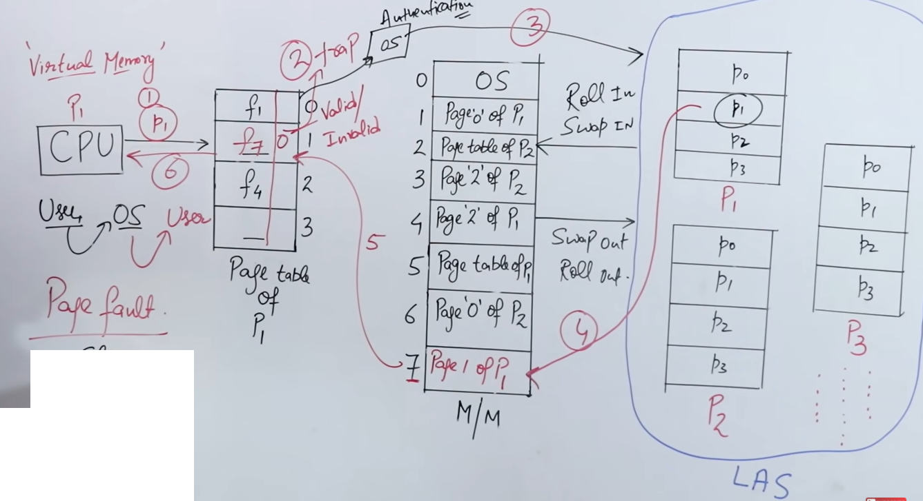
https://www.youtube.com/watch?v=o2_iCzS9-ZQ
Only for understanding

Slide 40
Pentium Features
Internal Parity Checking
Parity checking for data integrity is done very rigorously in Pentium.
Pentium checks parity on both the external processor pins, and the internal data structures.
Cache, buffers, and microcode ROM are all parity checked.
Additionally, the Pentium supports Functional Redundancy Checking (FRC) [error detection CRC- Cyclic Redundancy Check(CRC) for Error Detection and Correction | Computer Networks]

Slide 41
Pentium features
Bus cycle pipeline
The Pentium is “superscalar pipelined architecture.”
Superscalar means that the CPU can execute two (or more) instructions per cycle.
To be more precise: The Pentium can generate the results of two instructions in a single clock cycle.
The 80486 and Pentium have five-stage pipelines.

Slide 42
Pentium Super Scalar Architecture - Details

Slide 43
Pentium Architecture
Components of Pentium Architecture

Slide 44
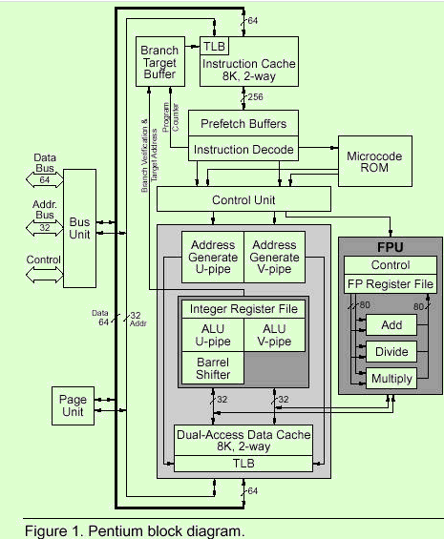
Pentium Architecture Detailed view

Slide 45
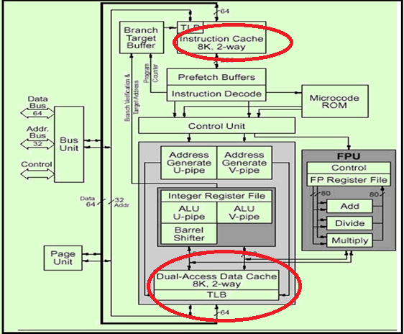
On Chip Caches
On Chip two integrated cache – 8Kbyte Data and 8 Kbyte Code Cache
Data Cache Supports MESI (Modify/Exclusive/Shared/Invalid) write back cache consistency Protocol.
Data cache is configurable as Write Through or Write Back on a line-by-line basis.
Code cache is write protected, supports Shared and Invalid stages of MESI Protocol
Cache is organized as a 2-way set associative cache.
Replacement in both the data and code caches is handled by the LRU
( Least Recently used) mechanism.
The data cache can be accessed simultaneously from both pipes, as long as the references are to different cache banks.

Slide 46
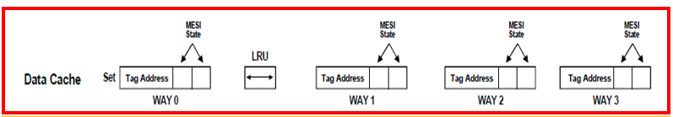
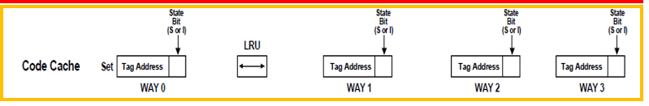
On Chip Caches
Data cache supports the MESI ((Modify/Exclusive/Shared/Invalid) write back cache consistency protocol which requires 2 state bits.
The code cache supports the S and I state only and therefore requires only one state bit.

Slide 47
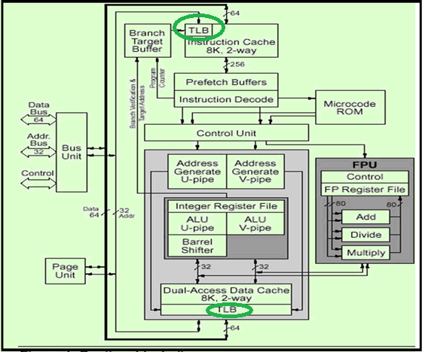
TLB - Translation Look Aside Buffer
Each of the caches are accessed with physical addresses and each cache has its own TLB
TLB translates linear address to physical address as required for paging technique
Number of TLB entries = 256

Slide 48
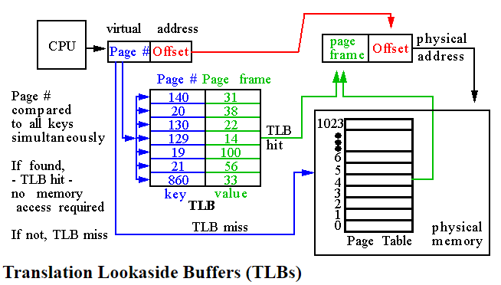
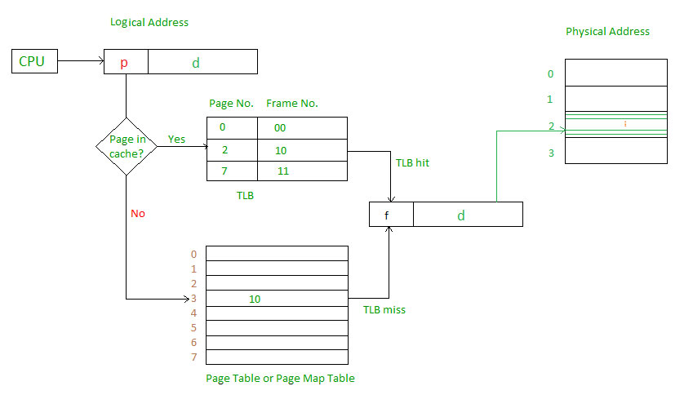
TLB - Translation Look Aside Buffer
A TLB is organized as a fully associative cache and typically holds 16 to 512 entries. Each TLB entry holds a virtual page number and its corresponding physical page number.
In general, the processor can keep the last several page table entries in a small cache called a translation lookaside buffer (TLB). The processor “looks aside” to find the translation in the TLB before having to access the page table in physical memory. In real programs, the vast majority of accesses hit in the TLB, avoiding the time-consuming page table reads from physical memory.

Slide 49
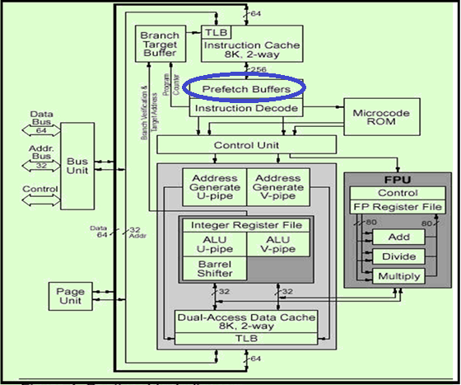
Pre-fetch Buffer
To support Branch Prediction Pentium implements Two Pre-fetch Buffers.
One to pre-fetch code in a linear fashion.
Other to pre-fetches code according to the Branch Target Buffer (BTB) so the needed code is almost always pre-fetched before it is needed for execution.
Two independent pairs of line-size (32-byte) pre-fetch buffers operate in conjunction with the branch target buffer.
Only one pre-fetch buffer actively requests pre-fetches at any given time.
Pre-fetches are requested sequentially until a branch instruction is fetched.

Slide 50
Role of Pre-fetch Buffer in Branch Prediction
When a branch instruction is fetched, branch target buffer (BTB) predicts whether the branch will be taken or not.
If predicted not taken, pre-fetch requests continue linearly.
On a predicted taken branch the other pre-fetch buffer is enabled and begins to pre-fetch as though the branch was taken.
If a branch is discovered mis-predicted, the instruction pipelines are flushed and prefetching activity starts over.
Example code:
Branching instruction: JNZ
Execution sequence: I0, I1, I2 and I3
Decision at I3:
If condition is true (i.e. ZF = 0) then after I3; I1 and I2 will be executed.
So pipeline must have instructions prefetched as I0 I1 I2 I3 I1 I2 I3 I1 I2 I3 and so on instead of I0 I1 I2 I3 I4, I5 and I6
If condition is false (i.e. ZF = 1) then after I3; I4, I5 and I6 will be executed.
So pipeline must have instructions prefetched as I0 I1 I2 I3 I4, I5 and I6
I0 MOV SI, addr
Bk : I1 INC SI
I2 DEC CX
I3 JNZ BK
I4 ADD AX,BX
I5 INC AX
I6 MOV [SI] , AX

Slide 51
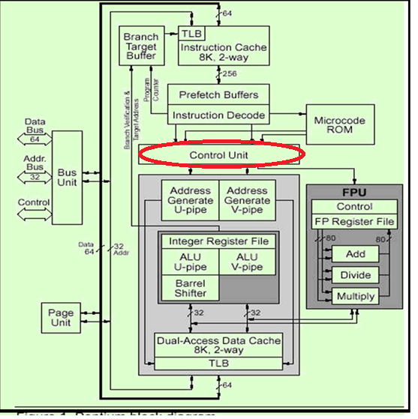
Control Unit
It interprets the instruction word and microcode entry point fed to it by Instruction Decode Unit.
It handles exceptions, breakpoints and interrupts.
It controls the integer pipelines and floating point sequences.
Microcode ROM: Stores microcode sequences.

Slide 52
Pentium Superscalar Architecture with details of pipeline stages
https://www.youtube.com/watch?v=x2yo2aDMHfA

Slide 53
Pentium Super-Scalar architecture
Pentium is capable of executing 2 integer or 2 floating point instructions simultaneously.
This parallel execution is done through two instruction pipelines, the “u” pipe and the “v” pipe.
The u-pipe can execute all integer and floating-point instructions.
The v-pipe can execute simple integer instructions and the FXCH floating-point instruction.
Processors capable of parallel instruction execution of multiple instructions are known as Superscalar machines.

Slide 54
U and V Pipelines
U pipeline :Capable of handling full instruction set. The u-pipe can execute all integer and floating-point instructions.
V pipeline :Only simple instructions. The v-pipe can execute simple integer instructions and the FXCH floating-point instruction.
Simple Instructions
- are hardwired and do not need microcode, execute in one clock cycle ( Few are listed below)
mov reg, reg/mem/imm
mov mem, reg/imm
alu reg, reg/mem/imm
alu mem, reg/imm
inc reg/mem
dec reg/mem

Slide 55
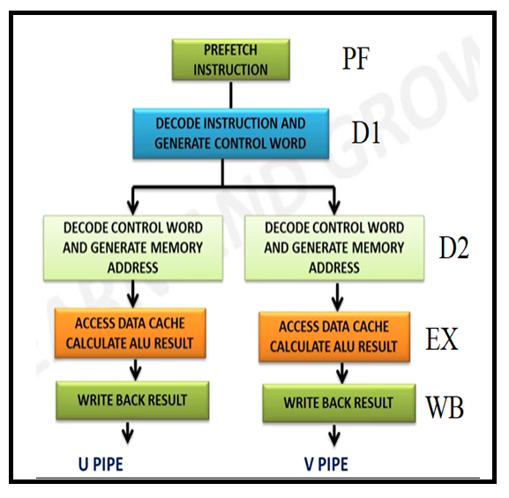
Pipelining
Pentium Processor Integer Pipeline with 5 Stages.
Pre fetch (PF):
Decode1:
Decode2:
Execute (EX):
Write Back (WB):

Slide 56
Pipelining stages Details
Stage 1
Pre fetch (PF)
Instructions are pre fetched from the on-chip instruction cache or memory. ADD AL,BL

Slide 57

Details of Prefetch Pipeline stages of Pentium
The first stage of the pipeline is the Prefetch (PF) stage in which instructions are prefetched from the on-chip instruction cache or memory.
Because the Pentium processor has separate caches for instructions and data, prefetches do not conflict with data references for access to the cache.
In the PF stage, two independent pairs of 32-byte prefetch buffers operate in conjunction with the branch target buffer.
This allows one prefetch buffer to prefetch instructions sequentially, while the other prefetches according to the branch target buffer predictions

Slide 58
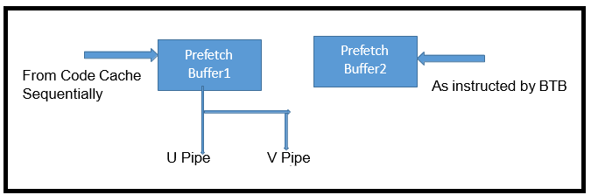
Prefetch stage
Two pre fetch buffers, 32bytes each.
At a time only one pre fetch buffer is connected to u and v pipes.
The buffer connected to the pipes-
- fetches instructions from code cache sequentially.
The other prefetch buffer
- fetches the instructions as directed by BTB.
Prefetch Buffer1
3/14/2019
35

Slide 59
Pipelining stages Details
Stage 2
Decode1
The decoders decodes instructions and decides whether they can be paired (control word generator)
Two parallel decoders attempt to decode and issue the next two sequential instructions.
The decoders determine whether one or two instructions can be issued (the instruction pairing rules ).

Slide 60
Pipelining stages Details
Stage 3
Decode2:
The D1 stage is followed by Decode2 (D2)
Addresses of memory resident operands are calculated (decode control word and generate memory address).

Slide 61
Pipelining stages Details
Execute (EX): Execute the instructions with data Cache and ALU access
Stage 4

Slide 62
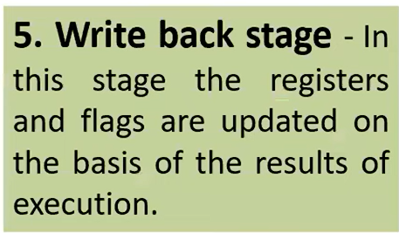
Pipelining stages Details
Write Back (WB): Modify processor state and complete execution.
Stage 5

Slide 63
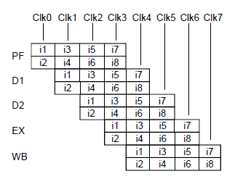
Instruction flow in Pentium pipeline

Slide 64
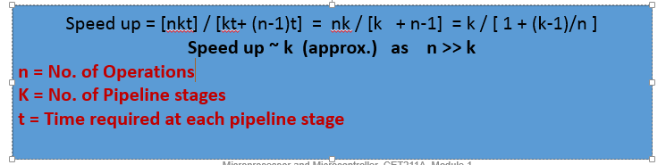
Pipeline performance
The maximum throughput is observed with-pipeline
Every instruction takes exactly one clock cycle to execute
No or minimum Stalls in pipeline
The number of clock cycles = m+(n-1) where
m = Number of stages in a pipeline
n = Number of instructions in a program
Example: A sequence of 1000 instructions will require 3000 (3*1000) clk cycles on a non pipelined machine and only 1002=(3+1000-1) cycles when pipelined!

Slide 65
Pipeline stall at decode and execute stage of pipeline

Slide 66
Execution Unit - creating Stall / bubble
I1, I3, I4 : Simple instructions : 1 CLK Cycle
I2 : Multiplication Instruction : 4CLK Cycles
Prfetch Buffer
STALL
I5
I4
I3
I2
I1
Decode1
Decode2
Execution
WriteBack

Slide 67
Decode2 : Operand fetch, Address generation - creating stall
I1, I2, I4 : Simple instructions : 1 CLK Cycle
I3 : mov ax, buffer[bx+si] : 4CLK Cycles
Prfetch Buffer
I5
STALL
I4
I3
I2
I1
Decode1
Decode2
Execution
WriteBack

Slide 68
Decode1 :Instr. Decoding, instruction pairing – creating Stall
I1, I2, I3 : Simple instructions : 1 CLK Cycle
I4 : Xchg : 4CLK Cycles
Prfetch Buffer
STALL
I5
I4
I3
I2
I1
Decode1
Decode2
Execution
WriteBack

Slide 69
Instruction Pairing Rules

Slide 70
Instruction Pairing Restrictions /Rules for parallel execution
Both must be simple instructions.
No data dependencies may exist between them.
For floating point instructions pairing:
The first instruction of the pair can be – FLD, FLD st(i), FADD, FMUL, FDIV, FCOM, FTST(test floating-point (compare with 0.0)), FABS (absolute value), FCHS (Change Sign- Complements sign of ST(0) This operation changes a positive value into a negative value of equal magnitude or vice versa.
The second instruction must be FXCH . https://docs.oracle.com/cd/E18752_01/html/817-5477/eoizy.html
Read after Write Hazard/ Flow dependence Ex. MOV AX, BX MOV DX, AX | Write after Write Hazard/ Output dependence Ex. MOV AX, BX MOV AX, CX

Slide 71
Instruction Pairing Restrictions /Rules for parallel execution
3. Neither instruction may contain both immediate data and a displacement value (MOV TABLE[SI],7).
4. Prefixed instructions may execute only in U pipeline (MOV ES:[DI],AL).

Slide 72
Branch Prediction
https://www.youtube.com/watch?v=rJAEGbpRrL4
https://www.youtube.com/watch?v=yk-U6qqeGE0

Slide 73
Branch Prediction
Performance gain through pipelining can be reduced by the presence of program transfer instructions (such as JMP, CALL, RET and conditional jumps).
They change the sequence causing all the instructions that entered the pipeline after program transfer instruction invalid.
Suppose instruction I3 is a conditional jump to I1 at some other address (target address), then the instructions that entered after I3 is invalid and new sequence beginning with I1 need to be loaded in.
This causes bubbles in pipeline, where no work is done as the pipeline stages are reloaded.
I0 MOV SI, addr
Bk : I1 INC SI
I2 DEC CX
I3 JNZ BK
I4 ADD AX,BX
I5 INC AX
I6 MOV [SI] , AX

Slide 74
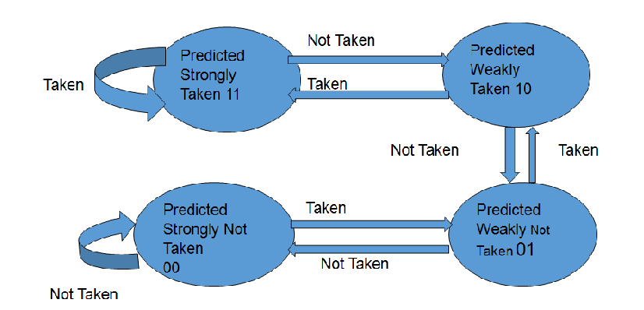

Branch Prediction Continued…
In this scheme, a prediction is made with reference to the branch instruction currently in pipeline.
Prediction will be either taken or not taken.
If the prediction turns out to be true, the pipeline will not be flushed and no clock cycles will be lost.
If the prediction turns out to be false, the pipeline is flushed and started over with the correct instruction.
To avoid this problem, the Pentium uses a scheme called Dynamic Branch Prediction.
Algorithm implemented in Pentium for reducing pipeline stalls during execution of jmp instructions
It contains a Branch prediction state machine with four states:

Slide 75
Branch Prediction Algorithm

Slide 76
Branch Prediction
The Pentium processor uses a Branch Target Buffer (BTB) to predict the outcome of branch instructions which minimizes pipeline stalls due to pre-fetch delays.
Algorithm implemented in Pentium for reducing pipeline stalls during execution of jmp instructions
It contains a Branch prediction state machine with four states:
(1) strongly not taken - 00
(2) weakly not taken - 01
(3) weakly taken - 10
(4) strongly taken - 11

Slide 77
Branch Prediction Algorithm
Two 32 bytes prefetch buffers work with BTB.
One fetches instruction from the current program address and the other buffer is activated when the branch BTB predicts “Taken”.
Initially History bits are 11, when a new target address is placed in BTB.
Whenever branch instruction is encountered, these bits are updated.
If the branch is not taken repetitively then History bits become 00.
BTB is accessed with the address instruction during D1 stage.
If found and the BTB’s prediction is “Taken”, second prefetch buffer becomes active.
If a new branch instruction is encountered (no target address in BTB), the prediction is “Not taken”.

Slide 78

Branch Prediction Algorithm

Slide 79

Example of Branch prediction and subsequent explanation
I0 MOV SI, addr
Bk : I1 INC SI
I2 DEC CX
I3 JNZ BK
I4 ADD AX,BX
I5 INC AX
I6 MOV [SI] , AX
In this example:
Instruction I3 is branching instruction which will work on the condition based on zero flag.
Condition will be True if ZF = 0, not set and branching will happen; means execution sequence will change from current location (source location i.e. I3) to target location (i.e. I1 or label Bk)
If condition is False i.e. ZF=1; execution sequence will be from current location (I3) to next location (I4) and so on.
When I3 is getting executed first time there is no history associated with it and hence BTB contents will be either 00 or garbage values i.e. no meaning associated with it.
In pipeline at D1 stage, the instruction is decoded and system knows whether it is branching instruction or not.
At Ex stage of pipeline, system comes to know whether branching will take place or not and hence at this stage BTB contents are updated and used for next iteration of the loop.

Slide 80
Example -
First time execution of branching instruction JNZ Bk
During D1 stage, the JNZ instruction is not known to BTB.
so it’s miss, thus predicts
NO JUMP WOULD BE TAKEN
Accordingly the subsequent instructions I4, I5 … has entered in pipeline.
This is illustrated in next slide.
I0 MOV SI, addr
Bk : I1 INC SI
I2 DEC CX
I3 JNZ BK
I4 ADD AX,BX
I5 INC AX
I6 MOV [SI] , AX

Slide 81
T1 CLK
T2 CLK
T5 CLK
Control Hazard
U pipe
U pipe
U pipe
3
4
7
2
3
6
1
2
5
D1
; I0 MOV SI, addr
Bk : I1 INC SI
I2 DEC CX
I3 JNZ BK
I4 ADD AX,BX
I5 INC AX
I6 MOV [SI] , AX
D2
1
4
Ex
3

Slide 82


The EX stage (Execute stage) gives feedback to BTB – Branch actually to be taken.
Actions taken further are :
1. BTB is updated as below
2. Pipeline flushed and Instructions I4, I5, I6 and I7 which are entered in pipeline are cleared.
3. Instructions fetched from new address “BK” (I1 and I2 ) in the pre fetch buffer2
4. Pre fetch buffer 2 connected to the pipeline and it behaves as main buffer/ buffer 1 as long as branching takes place.
These actions are illustrated in next slide.
I0 MOV SI, addr
Bk : I1 INC SI
I2 DEC CX
I3 JNZ BK
I4 ADD AX,BX
I5 INC AX
I6 MOV [SI] , AX

Slide 83
First occurrence of JNZ
Pre fetch Buffer 1
Pre fetch Buffer 2
Bring correct instruction from code cache
7
2
6
IP
1
Connect buffer 2
5
I0 MOV SI, addr
Bk : I1 INC SI
I2 DEC CX
I3 JNZ BK
I4 ADD AX,BX
I5 INC AX
I6 MOV [SI] , AX
Flush the pipeline
4
3

Slide 84
Prefetch Buffer 1
Prefetch Buffer 1
3
4
2
U pipe
3
1
2
D1
D2
1
Ex

Slide 85

Second occurrence of “JNZ” instruction
I0 MOV SI, addr
Bk : I1 INC SI
I2 DEC CX
I3 JNZ BK
I4 ADD AX,BX
I5 INC AX
I6 MOV [SI] , AX
BTB Hit, Prediction – Branch Strongly taken when reaches Execute Stage
BTB instructs prefetch stage to fetch instructions from addr. “BK”
One buffer prefetches instructions from target ie. I1 and I2
Second buffer prefetches instructions I4, I5 and so on.
During last iteration, when ZF=1 then branching will not happen and new instructions will be readily available in one of the buffer hence the correct buffer will be attached to U and V pipe.

Slide 86
BTB Example
Consider the following loop for computing prime numbers:
for(k=i+prime;k<=SIZE;k+=prime)
flags[k]=FALSE;
A popular compiler generates the following assembly code:
(prime is allocated to ecx, k is allocated to edx, and al contains the value FALSE)
inner_loop:
mov byte ptr flags[edx],al
add edx,ecx
cmp edx, SIZE
jle inner_loop
Each iteration of this loop will execute in 6 clocks on the Intel486 CPU.
On the Pentium processor, the mov is paired with the add; the cmp with the jle. With branch prediction,each loop iteration executes in 2 clocks.

Slide 87

Floating Point Unit Details

Slide 88
Floating Point Unit
The floating-point unit (FPU) of the Pentium processor is integrated with the integer unit on the same chip.
It is heavily pipelined.
The Pentium processor FPU is implemented with 8 pipeline stages.
First 5 stages are shared with Integer Unit.
The integer instruction uses the fifth stage as writeback.

Slide 89
Floating Point instructions in the pipeline
FP instruction does not get paired with integer instruction
Two FP instructions can be paired only if
a. FXCH instruction is the second instruction in the pair.
b. The first instruction of the pair can be – FLD, FLD st(i), All forms of FADD, FMUL, FDIV, FCOM, FUCOM, FTST, FABS, FCHS
c. The instructions which do not follow a and b always are issued to “u” pipe singly.

Slide 90
Floating Point Unit (FPU) – Key Points
FPU of Pentium is Integrated with Integer Unit
FPU is Heavily Pipelined Unit
Able to accept one floating point instruction / clock
Able to accept two floating point instruction every clock - But – One instruction out of it must be EXCHANGE - FXCH

Slide 91

Floating Point Unit Pipeline Stages
FPU Works with 8 Pipeline stages
It shares first 5 stages of Integer Unit
PF- Prefetch
D1- Instruction Decode
D2- Address Generation
EX- Memory & Register Read
X1- FP Execute Stage 1
X2- Execute Stage 2
WF- Write Result
ER- Error Reporting

Slide 92

8 pipeline stages of FPU with Bypass 1 and Bypass 2
5. X1 - Floating-Point Execute stage one : conversion of external memory format to internal FP data format and write operand to FP register file; bypass 1 (send data back to EX stage)
6. X2 - Floating-Point Execute stage two
7. WF - Perform rounding and write floating-point result to register file; bypass 2 (send data back to EX stage)
8. ER- Error Reporting/Update Status Word
PF - Prefetch
D1 - Instruction Decode
D2 - Address generation
EX - Memory and register read : conversion of FP data to external memory format and memory write.

Slide 93

Floating Point Pipeline with Bypass
FLD ST
FMUL ST
FADD NUM
FMUL NUM1
FLD ST
FMUL ST
Bypass 1:
Bypass 2:
FADD NUM
FMUL NUM1

Slide 94

FPU Register File

Slide 95
Impact of Bypass Technique
With bypass technique, the result from the previous instruction is about to be written to the register file, is made directly available as an operand to any succeeding instruction that needs it.
Two Types: Bypass 1 and Bypass 2

Slide 96
Bypass 1 Details
Bypass 1, the X1 stage register file write port and the EX stage register file read port.
With bypass 1, the result of a floating-point load (that writes to the register file in the X1 stage) can bypass the X1 stage write and be sent directly to the operand fetch stage or EX stage of the next instruction..

Slide 97
BYPASS 1 Example
Bypass connects the output of X1 stage to the input of EX stage
e.g - FLD ST
FMUL ST
The above instructions use ST as an operand.
With byapss1, the data from FLD is made available as an input operand to FMUL before it is written into the floating point register file.
This prevents the pipeline from stalling and decreases number of clk cycles.
No of clk cycles taken by 8087 to execute FMUL instruction are 130 whereas, Pentium takes only 1 clk cycle to perform the same operation!

Slide 98
Bypass 2 Details
Bypass the WF stage register file write port and the EX stage register file read port.
With bypass 2, the result of any arithmetic operation can bypass the WF stage write to the register file, and be sent directly to the desired execution unit as an operand for the next instruction.

Slide 99
BYPASS 2 Example
Bypass between WF stage and EX stage where the result of an arithmetic instruction is made available to the next instruction.
e.g. – FADD NUM
FMUL NUM1
The first instruction does
Top of stack 🡸 Top of stack + NUM
It does this in WF stage of the pipeline.
The next instruction “FMUL NUM1” does
Top of stack 🡸 Top of stack X NUM1
With bypass2, even before the result is written to top of the stack in register file, the result is directly forwarded to the next instruction “FMUL NUM1” in its EX stage.

Slide 100
System Level Architecture Overview Programmers Model

Slide 101

System Level Architecture
Programmers
Model ----
Set of Register
Data Structures
Instructions

Slide 102
Register categories
Flag Register
EFLAGS
Memory Management Registers
GDTR, LDTR, TR, IDTR
Control Registers
CR0,CR1,CR2,CR3, CR4
Debug Registers
DR0, DR1, DR2, DR3, DR4, DR5, DR6, DR7
General purpose registers
EAX,EBX,ECX,EDX
Index Registers
ESI,EDI
Pointer Registers
ESP,EBP
Segment Registers
DS,CS,SS,ES,FS,GS
Debug Registers
Index Registers
Segment Registers
Pointer Registers
General Purpose Registers
Memory Management Registers
Flag Registers
Control Registers

Slide 103
Register Categories
General purpose registers
EAX,EBX,ECX,EDX
Index Registers
ESI,EDI
Pointer Registers
ESP,EBP
Segment Registers
DS,CS,SS,ES,FS,GS
Flag Register
EFLAGS
Memory Management Registers
GDTR, LDTR, TR, IDTR
Control Registers
CR0,CR1,CR2,CR3, CR4
Debug Registers
DR0, DR1, DR2, DR3, DR4, DR5, DR6, DR7

Slide 104

Application Registers

Slide 105

Segment Registers
Six Segment Registers
Each with 16 bit capacity
Used to hold distinct content
Code
Data
Stack

Slide 106

EFLAG Registers
Carry Flag
Auxiliary Flag
Sign
Flag
Overflow
Flag
Trap
Flag
Parity Flag
Zero
Flag
Direction
Flag
Interrupt
Flag

Slide 107

EFLAG Registers
IOPL – Indicates the I/O Privilege level of Currently running program / Task 00-01 10 11
CPL <= IOPL to access IO Address Space
Nested Task – control chaining of Interrupted and called tasks
Resume Flag – controls the processors response to “Instruction Breakpoint” Condition.
VM – to set Virtual 8086 mode.
AC- Alignment Check– when set enable alignment checking of memory references (along with AM flag in CR0)

Slide 108

EFLAG Registers
Virtual Interrupt Flag (VIF) – contains a Virtual image of IF flag, works along with VIP bit.
Virtual Interrupt Pending (VIP) – Indicated that an interrupt is pending works along with VIF
“To Consider these flags, either VME or PVI flag of CR4 need to be set and IOPL < 3”
Identification –ability of program to set/clear this bit indicates support for the CPUID instruction

Slide 109

EFLAG Registers

Slide 110

Control Registers
20 Bits (31-12)

Slide 111
Control Register- CR0 Extra Information
Bit | Name | Full Name | Description
0 | PE | Protected Mode Enable | If 1, system is in protected mode, else, system is in real mode
1 | MP | Monitor co-processor | Controls interaction of WAIT/FWAIT instructions with TS flag in CR0
2 | EM | Emulation | If set, no x87 floating-point unit present, if clear, x87 FPU present
3 | TS | Task switched | Allows saving x87 task context upon a task switch only after x87 instruction used
4 | ET | Extension type | On the 386, it allowed to specify whether the external math coprocessor was an 80287 or 80387
5 | NE | Numeric error | Enable internal x87 floating point error reporting when set, else enables PC style x87 error detection
16 | WP | Write protect | When set, the CPU can't write to read-only pages when privilege level is 0
18 | AM | Alignment mask | Alignment check enabled if AM set, AC flag (in EFLAGS register) set, and privilege level is 3
29 | NW | Not-write through | Globally enables/disable write-through caching
30 | CD | Cache disable | Globally enables/disable the memory cache
31 | PG | Paging | If 1, enable paging and use the CR3 register, else disable paging.

Slide 112


Slide 113
Memory Management Registers

Slide 114

Memory Management Registers
GDTR – Global Descriptor Table Register
IDTR – Interrupt Descriptor Table Register
LDTR- Local Descriptor Table Register
TR – Task Register

Slide 115

GDTR
Hold linear address of Base of Global Descriptor Table
The GDTR register holds the 32-bit base address and 16-bit table limit for the GDT.
The base address specifies the linear address of byte 0 of the GDT
the table limit specifies the number of bits in the each table.
64 Bit
64 Bit
64 Bit
64 Bit
64 Bit
64 Bit
64 Bit
Base Address=32 Bit
2^16=64KB=65536
2^13=8192
8192*8=64KB
32 bit BA
16 bit Table Limit
GDTR

Slide 116
IDTR
IDTR holds the linear address of the base of the IDT
32-bit base address and 16-bit table limit for the IDT.
Base address specifies the linear address of byte 0 of the IDT
Table limit specifies the number of bytes in the table.
External interrupts, software interrupts, and exceptions are handled through the interrupt descriptor table (IDT).
IDT contains a collection of gate descriptors, to access interrupt and exception handlers.
LIDT & SIDT instructions load and store the IDTR register, respectively

Slide 117
LDTR
The linear address of the LDT is contained in the LDT register (LDTR).
LDT contain entries called segment descriptors which provides the base address of a segment and access rights, type, and usage information.
LDTR register holds the 16-bit segment selector, 32-bit base address, 16-bit segment limit, and descriptor attributes for the LDT.
Base address specifies the linear address of byte 0 of the LDT segment. The segment limit specifies the number of bytes in the segment.
LLDT and SLDT instructions load and store the segment selector part of the LDTR register.

Slide 118
Task Register
Task register holds
16-bit segment selector
32-bit base address
16-bit segment limit,
Descriptor attributes for the TSS of the current task.
Base address specifies the linear address of byte 0 of the TSS
Segment limit specifies the number of bytes in the TSS.
LTR and STR instructions load and store the segment selector part of the task register

Slide 119

Control Registers
Control Registers (CR0, CR1, CR2, CR3, and CR4) determine operating mode of the processor and the characteristics of the currently executing task

Slide 120
Control Registers
CR0 – Defines paging, protection, extension type, task switched etc.
CR1 – Reserved
CR2 - Contains the Page Fault Linear Address
CR3 - Contains Physical address of base of Paging (PDBR) Mechanism, MSB 20 bits are specified and LSB 12 are assumed 0.
CR4 - Additional control bits

Slide 121
Important bits of Control Registers
PG – Paging Bit 31 of CR0 – for enabling and disabling paging mechanism
PE- Protection Enable bit 0 of CR0 – enables protected mode
VME- Virtual 8086 Modes Extension – bit 0 of CR4- enable interrupt and exception handling in virtual 8086 mode

Slide 122

Debug Registers
DR0 through DR7 are available for debugging and performance monitoring.
Holds address of memory or IO location called Breakpoints
A debug exception occurs (#DB) when a memory or IO access is made to a breakpoint address.

Slide 123

Data Types
Byte, word, doubleword and quadword are principal data types i.e 8 bit, 16, 32 and 64 bits.
In case of any size, the lowest address is refereed always. Higher address are only used when upper byte/word/double/quad is accessed separately from the lower or when individual bytes are being accessed.

Slide 124

Data Types
Bytes,
Words,
Doublewords
Quadwords storage in Memory

Slide 125
Data Types
Integer - All operations assume a two's complement representation. MSB is used as sign bit. The value of an 8-bit integer is from –128 to +127; a 16-bit integer from –32,768 to +32,767; a 32-bit integer from –231 to +231 –1
Ordinal: An unsigned binary number contained the value of an 8-bit ordinal is from 0 to 255; a 16-bit ordinal from 0 to 65,535; a 32-bit ordinal from 0 to 2^32 – 1. This is sometimes referred to as an unsigned integer.
BCD Integer: A representation of a binary-coded decimal (BCD) digit in the range 0 through 9. Unpacked decimal numbers are stored as unsigned byte quantities.
Packed BCD Integer: A representation of binary-coded decimal digits, each in the range 0 to 9. One digit is stored in each half-byte, two digits in each byte. The digit in bits 4 to 7 is more significant than the digit in bits 0 to 3. Values 0 to 9 are valid for a digit.

Slide 126
Data Types
Near Pointer: A 32-bit effective address. A near pointer is an offset within a segment. Near pointers are used for all pointers in a flat memory model, or for references within a segment in a segmented model.
Far Pointer: A 48-bit logical address consisting of a 16-bit segment selector and a 32-bit offset. Far pointers are used in a segmented memory model to access other segments.
Bit Field: A contiguous sequence of bits. A bit field can begin at any bit position of any byte and can contain up to 32 bits.
Bit String: A contiguous sequence of bits. A bit string can begin at any bit position of any byte and can contain up to 23^2– 1 bits.
Byte String: A contiguous sequence of bytes, words, or doublewords. A string can contain from zero to 2^32 – 1 bytes (4 gigabytes).

Slide 127

Addressing Modes

Slide 128

Addressing Mode with Example

Slide 129

Addressing mode with example

Slide 130

Addressing Modes
Register Mode – operand is located in one of the general purpose register
Ex – MOV EAX, EBX
Immediate Mode- operand is included in instruction itself.
Ex – SHL Pattern, 2 or
Memory Mode need effective address calculations.
EA = Base + (Index*Scaling)+ Displacement
MOV AX, 45H

Slide 131
Few Important Rules
The ESP register cannot be used as an index register.
When the ESP or EBP register is used as the base, the SS segment is the default selection. In all other cases, the DS segment is the default selection.
The base, index, and displacement components can be used in any combination; any of these components can be null. A scale factor can be used only when an index also is used.
The displacement alone indicates the offset of the operand. This form of addressing is used to access a statically allocated scalar operand.

Slide 132
Few important Rules
BASE + DISPLACEMENT
A register and a displacement can be used together for two distinct purposes:
Index into an array when the element size is not 2, 4, or 8 bytes. The displacement component encodes the offset of the beginning of the array. The register holds the results of a calculation to determine the offset to a specific element within the array.
Access a field of a record. The base register holds the address of the beginning of the record, while the displacement is an offset to the field.

Slide 133
Few important Rules
(INDEX * SCALE) + DISPLACEMENT
This combination is an efficient way to index into a static array when the element size is 2, 4, or 8 bytes. The displacement addresses the beginning of the array, the index register holds the subscript of the desired array element, and the processor automatically converts the subscript into an index by applying the scaling factor.
BASE + INDEX + DISPLACEMENT
Two registers used together support either a two-dimensional array (the displacement holds the address of the beginning of the array) or one of several instances of an array of records (the displacement is an offset to a field within the record).
BASE + (INDEX * SCALE) + DISPLACEMENT
This combination provides efficient indexing of a two-dimensional array when the elements of the array are 2, 4, or 8 bytes in size

Slide 134

Few important Rules

Slide 135

Addressing Modes
The assembler assigns contiguous (offset addresses) memory space for the variables.
It uses the same ordering of variables that is present in the source code.
Finding the offset value of a variable is counting the number of bytes allocated to all the variables preceding it.
For example, the offset value of marks is 6 because value and sum are allocated 2 and 4 bytes, respectively.
Section .data
value DW 0
sum DD 0
marks TIMES 10 DW 0
message DB ’The grade is:’,0
char1 DB ?

Slide 136
Addressing mode with example
1/23/2023

Slide 137
Addressing mode with example

Slide 138
Addressing mode with example

Slide 139
Addressing mode with example

Slide 140
Instruction Set

Slide 141
Data Transfer Instructions
MOV Move
XCHG Exchange
PUSH/PUSHF Push onto stack
POP /POPF Pop off of stack
SAHF store AH into flags
IN Read from a port
OUT Write to a port
LDS Load far pointer using DS
LES Load far pointer using ES
LEA Load effective address
XLAT Exchange byte/word

Slide 142
Data Transfer Instructions
Additional Pentium instructions:
PUSHA Push ALL registers
POPA Pop ALL registers
INS Input string from port
OUTS Output string from port
LFS Load far pointer using FS
LGS Load far pointer using GS
LSS Load far pointer using SS
MOVSX Move and sign extend
MOVZX Move and zero extend
PUSHD/PUSHAD/PUSHFD Push DOUBLE registers onto stack
POPD/POPAD /POPFD Pop DOUBLE registers from stack
BSWAP Byte swap
MOV Move to/from control register

Slide 143
Binary Arithmetic Instructions
ADD Integer add
ADC Add with carry
SUB Subtract
SBB Subtract with borrow
IMUL Signed multiply
MUL Unsigned multiply
IDIV Signed divide
DIV Unsigned divide
INC Increment
DEC Decrement
NEG Negate
CMP Compare

Slide 144
Binary Arithmetic Instructions
Additional Pentium instructions:
CDQ convert double word to quad word
CWDE convert word to double word
CMPXCHG compare and exchange
XADD exchange and add
CMPXCHG8B compare and exchange 8bytes

Slide 145
Bit Manipulation Instructions
AND and
OR or
XOR Exclusive or
NOT Not
SAR Shift arithmetic right
SHR Shift logical right
SAL/SHL Shift arithmetic left/Shift logical left
SHRD Shift right double
SHLD Shift left double
ROR Rotate right
ROL Rotate left
RCR Rotate through carry right
RCL Rotate through carry left
TEST test byte/word

Slide 146
Bit manipulation Instructions
Additional Pentium instructions:
BSF Bit scan forward
BSR Bit scan reverse
BT Bit test
BTC Bit test and complement
BTR Bit test and reset
BTS Bit test and set
SHLD shift left double precision
SHRD shift right double precision
SETcc set byte on condition

Slide 147
Control Transfer Instructions
JMP Jump
JE/JZ Jump if equal/Jump if zero
JA/JNBE Jump if above/Jump if not below or equal
JL/JNGE Jump if less/Jump if not greater or equal
JC Jump if carry
JO Jump if overflow
JS Jump if sign (negative)
RET Return
IRET Return from interrupt
INT Software interrupt
INTO Interrupt on overflow
LOOPZ/LOOPE Loop with ECX and zero/Loop with ECX and equal

Slide 148
String Instructions
MOVS/MOVSB Move string/Move byte string
CMPS/CMPSB Compare string
SCAS/SCASB Scan string/Scan byte string
LODS/LODSB Load string/Load byte string
STOS/STOSB Store string/Store byte string
REP Repeat while ECX not zero
REPE/REPZ Repeat while equal/Repeat while zero
REPNE/REPNZ Repeat while not equal/Repeat while not zero

Slide 149
Flag Control Instructions
STC Set carry flag
CLC Clear the carry flag
CMC Complement the carry flag
CLD Clear the direction flag
STD Set direction flag
LAHF Load flags into AH register
SAHF Store AH register into flags
STI Set interrupt flag
CLI Clear the interrupt flag

Slide 150
Additional Pentium instructions:
BOUND Detect value out of range
ENTER High-level procedure entry
LEAVE High-level procedure exit
IRETD interrupt return
JECXZ jump if ECX is zero

Slide 151
Protected Mode Instructions
LGDT Load global descriptor table (GDT) register
SGDT Store global descriptor table (GDT) register
LLDT Load local descriptor table (LDT) register
SLDT Store local descriptor table (LDT) register
LTR Load task register
STR Store task register
LIDT Load interrupt descriptor table (IDT) register
SIDT Store interrupt descriptor table (IDT) register
MOV Load and store control registers
MOV Load and store debug registers

Slide 152
Protected Mode Instructions
LMSW Load machine status word
SMSW Store machine status word
CLTS Clear the task-switched flag
ARPL Adjust requested privilege level
LAR Load access rights
LSL Load segment limit
VERR Verify segment for reading
VERW Verify segment for writing

Slide 153
Additional Pentium instructions
INVD Invalidate cache, no writeback
WBINVD Invalidate cache, with writeback
INVLPG Invalidate TLB Entry
LOCK (prefix) Lock Bus
HLT Halt processor
RSM Return from system management mode (SSM)
RDMSR Read model-specific register
WRMSR Write model-specific register
RDPMC Read performance monitoring counters
RDTSC Read time stamp counter
CPUID Processor Identification

